Slide 1

Predicting Student Performance: An Early Warning System for Higher Education
Empowering university administrators and academic advisors with data-driven insights to foster student success and enhance retention.
Prepared by: Adham Ehab
Submitted to: MAIM digital solutions

Slide 2

Project Overview: Building a Proactive Support System
This project aims to develop an early warning system to identify students at risk of underperforming, enabling timely interventions and optimizing educational resource allocation.
01
02
03
Problem & Value
Methodology Overview
Key Phases
Proactively identify at-risk students to improve outcomes, increase retention, and optimize resources.
Structured approach from data preparation to actionable, ethically-sound recommendations.
Data Preparation & EDA
Student Segmentation (K-Means)
Risk Prediction (Classification)
Ethical Analysis & Recommendations

Slide 3

Data & Preparation: The Foundation of Our Analysis
Data Source & Scope
Two datasets from two Portuguese schools (student-mat.csv, student-por.csv).
395 and 649 student records, 33 diverse features.
Key Features
Demographics & Family Background
Social & Study Habits (e.g., goout, freetime, studytime)
Absences & Prior Grades (G1, G2)
Data Quality Assessment
No missing values or duplicate rows identified.
Outliers detected in 'failures' and 'absences' features, handled during preprocessing.

Slide 4
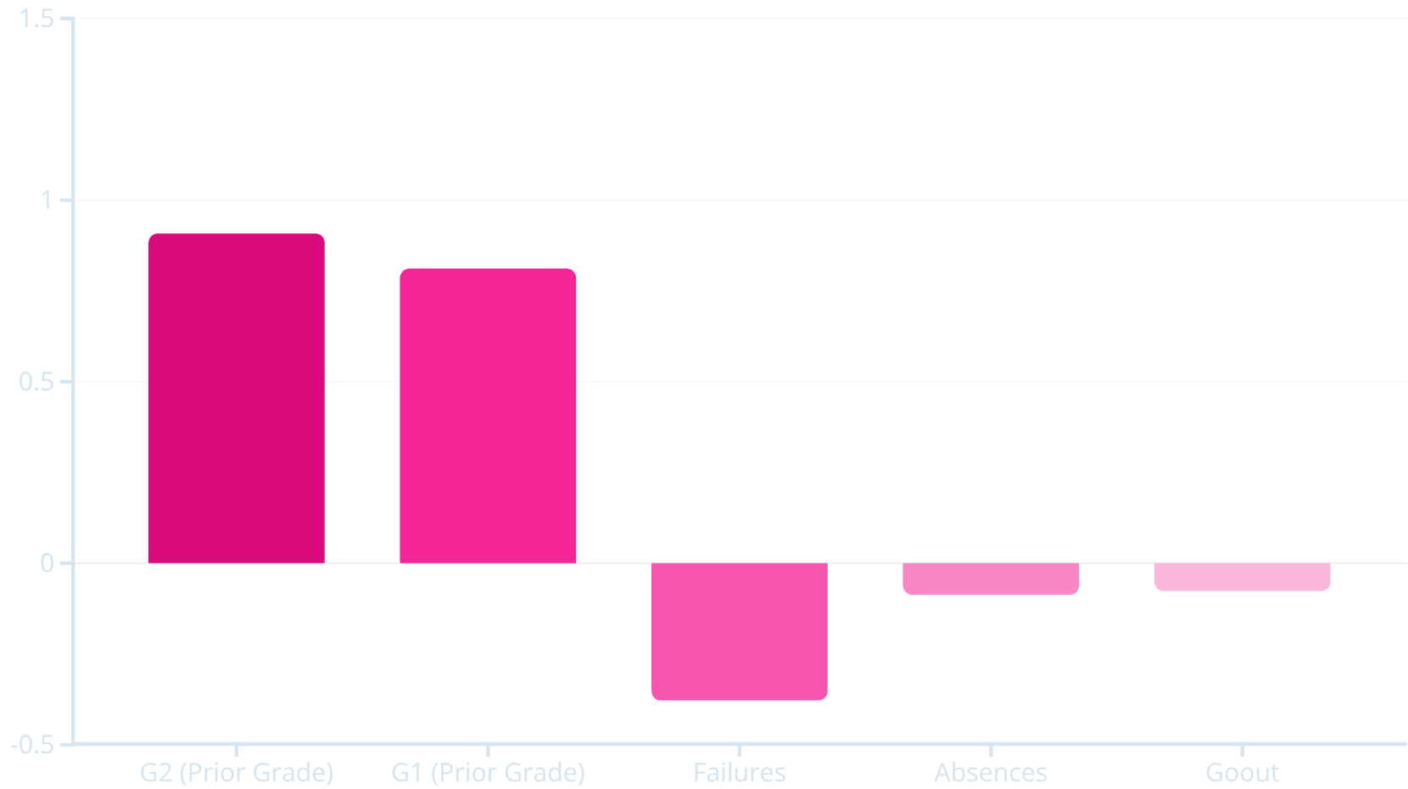
EDA & Key Drivers of Performance
Exploratory Data Analysis revealed critical insights into factors influencing final student grades (G3).
Prior Grades Dominate
Prior grades (G1, G2) are overwhelmingly predictive, with correlations of 0.81 and 0.91 with G3, respectively.
Negative Impact of Failures
Past failures show the strongest negative correlation (-0.38), indicating a significant risk factor.
Final Grade Distribution
G3 distribution is slightly left-skewed, with a mean of 11.34, suggesting a need to support students nearing the passing threshold.
These findings are crucial for informing feature selection in our predictive models.

Slide 5








Unsupervised Learning: Student Segmentation
K-Means clustering provided granular student segments based on early behavioral data, crucial for targeted interventions.
Clustering Approach
Behavioral Features
Applied K-Means using behavioral features available early in the term.
Study Time
Absences
Social Outings (goout)
Freetime
Family/School Support
Optimal Clusters (k=9)
Key Insights
Selected k=9 using the elbow method and silhouette scores for a detailed view of student behaviors.
Clusters with high absences and low study time showed significantly lower average final grades, affirming behavioral patterns as effective risk indicators.

Slide 6
Supervised Learning: Predicting Student Outcomes
We explored various machine learning models to predict student pass/fail status, considering two feature variants for a comprehensive evaluation.
Prediction Goal
Variant A: Benchmark
1
Predict if a student will pass (G3 >= 10) or fail.
Includes G1/G2. Establishes performance ceiling but demonstrates data leakage for early warning.
Models Evaluated
Logistic Regression
Variant B: Early Warning
2
Decision Tree
Random Forest
Excludes G1/G2. Focuses on behavioral and demographic features for true proactive detection.
Support Vector Machine (SVM)

Slide 7
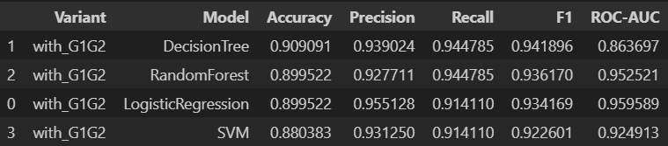
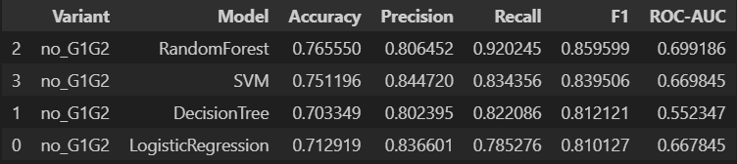
Supervised Learning Results: Models with Prior Grades
Including G1 and G2 dramatically boosts model performance, establishing a benchmark for predictive power when early academic history is available.
Performance Ceiling Established
Decision Tree: Achieved the highest F1 score of 0.949.
Logistic Regression: Demonstrated strong discrimination with a ROC-AUC of 0.959.
Insights
The exceptional performance of these models highlights the significant predictive power of early grades. While indicative of potential, this scenario suggests a "reactive" rather than "proactive" warning system due to reliance on academic performance rather than early behaviors.

Slide 8
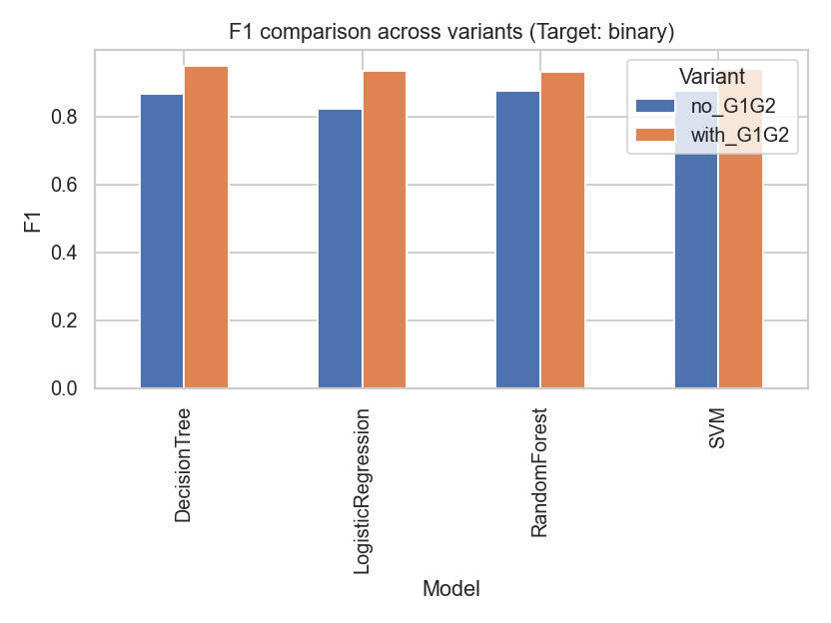
Supervised Learning Results: True Early Warning System
Without prior grades, performance naturally decreased, but models still provided viable early risk detection based on behavioral and demographic factors.
Robustness for Early Detection
Random Forest: Best-performing model with F1 score of 0.876 and ROC-AUC of 0.676.
Feature Importance: Failures and absences were identified as the most critical predictors, validating their use as early risk signals.
This demonstrates the model's ability to identify students at risk before academic struggles manifest in grades, enabling truly proactive intervention.

Slide 9


Actionable Recommendations: Empowering Student Success
Translating data insights into concrete strategies for university administrators and academic advisors.
1
2
3
Attendance Intervention
Targeted Study Support
Strategic Grade Leveraging
Implement programs to identify and address root causes of truancy early, leveraging the strong link between absences and underperformance.
Provide study skills workshops and tutoring for students identified by K-Means as having low study time or lacking support.
Use initial grades (G1) with behavioral data to confirm risk status and tailor support, moving beyond reactive measures.

Slide 10

Ethical Considerations: Ensuring Responsible AI Deployment
Addressing the critical ethical dimensions of using predictive analytics in higher education to ensure fairness and trust.
Data Privacy
Fairness & Bias
Mitigation: Strict data governance and anonymization to protect student identities.
Mitigation: Regular fairness audits to prevent perpetuation of existing disadvantages.
Stigmatization
Transparency
Mitigation: Reframe predictions as "support needs" to foster a positive environment.
Mitigation: Use interpretable models and provide clear reports on feature importance to build trust.

Slide 11

Conclusion 🎓
This project successfully demonstrates a data-driven approach to student support. By identifying key behavioral and academic signals, the models provide a reliable early warning system. The results confirm that proactive, data-informed interventions can be a powerful tool to improve student success and ensure no student falls through the cracks.

